Slide 1
Cybersecurity Workshop
December 7, 2017
DoubleTree Suites – Southcenter
Sponsored by King County Region 6 Critical Infrastructure Working Group
Facilitated by the Pacific NorthWest Economic Region’s (PNWER) Center for Regional Disaster Resilience (CRDR)
Paid for by a grant from the Department of Homeland Security (DHS); via Washington State Emergency Management Division and King County Office of Emergency Management

Slide 2
Wifi Network: Password:

Slide 3
Welcome and Introductions
Welcoming Remarks
Walt Hubbard, Director, King County Office of Emergency Management
Update from Region 6 Critical Infrastructure Working Group
Tommi Robison/Elizabeth Klute, Co-chairs of Region 6 Critical Infrastructure Working Group
Remarks from Rep. Zack Hudgins
Introductions of Participants

Slide 4
Recommendations from Emerald Down V, Feb--2017
Eric Holdeman, Director
Center for Regional Disaster Resilience (CRDR)
Pacific Northwest Economic Region (PNWER)

Slide 5
Recommendation Number 1
**Coordinate the development and enhancement of cybersecurity plans and procedures
Develop and improve cybersecurity plans and procedures
All hazard planning only goes so far
Multi-agency, public and private sector, planning workshops
Coordinated vertically and horizontally
**Being addressed today

Slide 6
Recommendation Number 2
Identify and develop procedures that support plans and Improve cyber response and recovery
Acknowledged value of Emerald Down Workshops, but…
Individual agency responsibilities
King County OEM, best positioned to lead regional planning coming out of Emerald Down events.
Note: Recommendation No. 6 also aligned with this recommendation

Slide 7
Recommendation Number 3
**Capitalize on the opportunity to leverage volunteer resources in cyber-response
Refine how cyber-volunteers can be used
Investigate use of WAC 118-04 Emergency Workers for this purpose
When and where possible, explore formal typing of personnel resources and establish Memoranda of Understanding (MOU) among organizations
**Being addressed today

Slide 8
Recommendation Number 4
**Region 6/King County continue annual Cybersecurity Workshops
Promote cross-jurisdictional work
Accent the multi-disciplinary impacts of cybersecurity
Encourage critical infrastructure interdependency work
**Being addressed today

Slide 9
Recommendation No. 5
Engage in more discussion on the impacts to business operational processes
Connect disaster recovery with business continuity planning and response

Slide 10
Recommendation No. 6
**Develop cybersecurity reporting and information sharing protocols
Ensure all levels of government are informed
Develop protocols for identifying specific events that would trigger reporting an incident
Note: Maritime Cybersecurity Situational Awareness Project—Handout
**Being addressed today

Slide 11
Cyber Incident Reporting Method: A Local Perspective
Panel:
Moderator: Ralph Johnson, CISO, King County
Rob Lang, Cyber Security Manager, Washington State Military Department
Natalie Stice, Homeland Security Coordinator, Pierce County Emergency Management
Allen Avery, Intelligence Analyst, Cyber and Critical Infrastructure, Washington State Fusion Center

Slide 12
Cyber Incident Reporting: Discussion & Report-out
Designate a person as the facilitator and notetaker
Designate a person to report out
Please turn in your notes and ideas at the end of the discussion
Discuss:
What internal reporting procedures or processes do you have in place today?
What, if any, regulatory barriers are there to sharing cybersecurity information outside of your organization or infrastructure sector?
What trust issues must be overcome to allow you to share cybersecurity information with other organizations?
Private Sector
Public Sector
To which organization do you prefer reporting cybersecurity intrusions?
Local law enforcement
FBI
Secret Service
U.S. Attorney’s Office
Washington State Fusion Center
Local Emergency Management Agency
State Emergency Management Agency
Other
What do you think the criteria should be for reporting cybersecurity intrusions? What should the threshold be for reporting incidents?

Slide 13
UNCLASSIFIED
WASHINGTON STATE FUSION CENTER
Cybersecurity Workshop
December 7, 2017
UNCLASSIFIED

Slide 14
Classification
UNCLASSIFIED
TLP: WHITE
(U) This information is the property of the Washington State Fusion Center and may be distributed to law enforcement officials, as well as to public and private sector stakeholders with a legitimate need-to-know. Further dissemination to authorized recipients is permitted without prior approval. Precautions should be taken to ensure this information is stored and/or destroyed in a manner that precludes unauthorized access.
(U) Recipients may share TLP: WHITE information with peers and partner organizations without restriction, but not via publicly accessible channels.

Slide 15
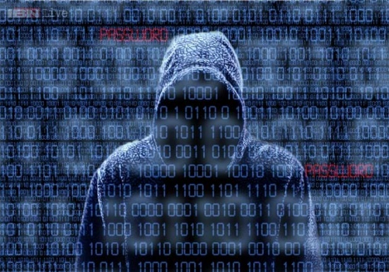
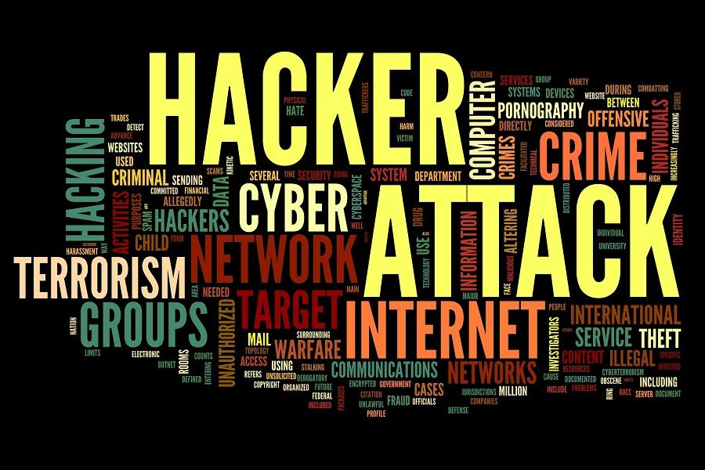
Agenda
WSFC Role
Capabilities
Reporting
What’s Next?
Questions
Notes:
This presentation is intended to cover what the capabilities in the fusion center were, are, and what we hope to provide in the future.

Slide 16
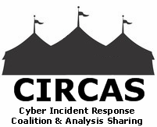
WA State Cyber Effort
Statewide Integration and Collaboration
WSFC
WSP
WA National Guard
FBI
CIRCAS
DHS
USSS
City of Seattle
Private Sector
CTS
WA EMD
Infragard
UW
Local and Tribal
MS-ISAC
Notes:
So, what is the WSFC doing in the cyber realm? First, this truly is a much larger effort than simply one entity. Collaboration among partners in the public and private arena truly make the overall effort to combat cyber threats effective. Working with several of the partners you see on the screen [name a few] we are taking the proactive approach to provide the information and support to you. [our territorial, tribal, local, state, and federal partners]
With that, some of the efforts we have had the ability to undertake in the past relied on the full-time cyber analyst within the WSFC. NEXT SLIDE
CTS = Consolidated Technology Services

Slide 17
WSFC Role
Past Capabilities
Technical
Block lists, IP analysis, review logs, etc.
Analytical
Threat actors, techniques, products
Full-time Cyber Intelligence Analyst
Stakeholder Support/Outreach
Malicious website list
Monitor PRISEM
Notes:
The capabilities and expert knowledge of our analyst allowed for supportive outreach and technical analysis of compromised systems, as well as analytical support for threat actors, tactics, techniques, and procedures (TTPs) discussed earlier.
One of the primary roles of the Cyber Analyst was to monitor PRISEM. NEXT SLIDE

Slide 18
PRISEM
Public Regional Information
Security Event Management
PRISEM was a unique DHS-funded community service, which aggregated and processed cyber-security logs and event data, provided correlated alerts, and extended cyber situational awareness across the greater Puget Sound region.
At the time, it was the only such system in the United States.

Slide 19
Who Shared Data with PRISEM?
CITIES COUNTIES PORTS
City of Seattle Kitsap County Port of Seattle
City of Kirkland Thurston County Port of Tacoma
City of Lynnwood Sno. County PUD Port of Everett
City of Redmond King County Port of Olympia
City of Bellevue Port of Anacortes
City of Issaquah Port of Port Angeles
Future Data-Sharing Initiative: PISCES
Public and Private Sector Partners

Slide 20
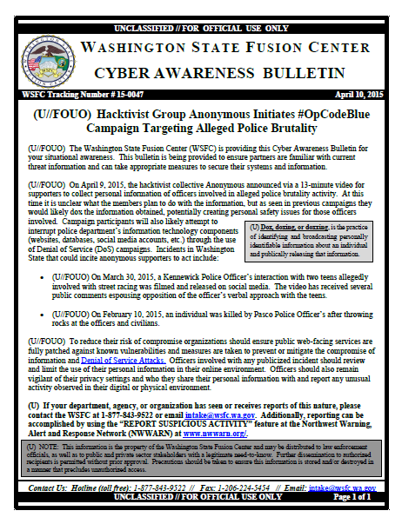
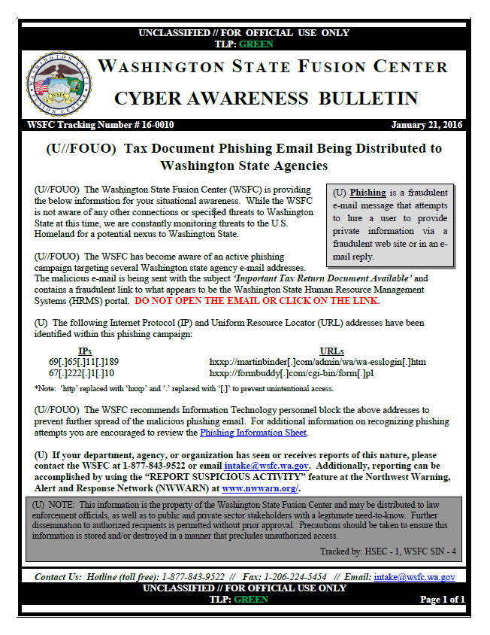
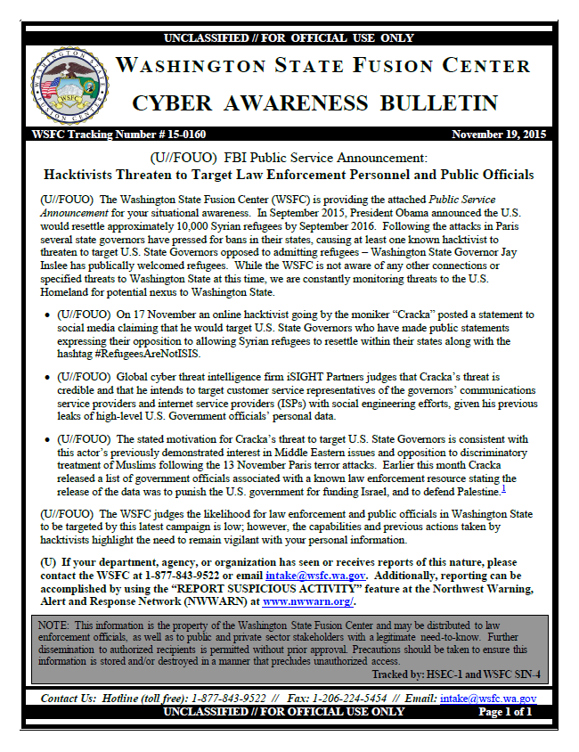
Current Capabilities
Produce and distribute Cyber Bulletins and Situational Awareness/Advisory /Informational products with actionable intelligence that are geared towards the information technology and information security audiences.
WSFC’s focus is on domestic cyber intelligence topics as they relate to our regional stakeholders and vetted partners.

Slide 21
Victim Notification
When we become aware of a compromised site we will reach out to the site administrator, and the fusion center in their AOR if outside of WA, and provide them information on the compromise.

Slide 22
Coordinated Effort
WA National Guard
WA Office of the CIO
WA Emergency Management Division
City of Seattle
Federal, State, Local, Tribal, Territorial, and Private Sector Partners
FBI
WSP HTCU
DHS
Many Others
Notes:
FBI partnership; USSS financial crimes; WSP efforts; City of Seattle coordination
National Guard training programs
WA Office of CIO – PISCES
WA EMD – COP, Incident Response, Mitigation, Recovery
The Washington State Significant Cyber Incident Annex to the State Comprehensive Emergency Management Plan. The WSCIA is intended to establish the strategic framework to prepare for, respond to, and begin to coordinate response to and recovery from a significant cyber incident.
Partners – Active investigations, partnerships, joint efforts
WSP High Tech Crimes Unit (HTCU) – Identifies compromised assets from state and local entities, confirms the presence of intrusion or compromise, and coordinates investigation with state, local, and federal partners.

Slide 23
Reporting to the Fusion Center
One stop shop for resources/reporting
Phishing attempts
Ransomware Attacks
DDoS / Degradation in Service
Known Intrusions
Business Email Compromise
Anything that can be shared
We do not identify compromised organization in products and alerts, only the threat information, indicators and origins.
intake@wsfc.wa.gov or 877-843-9522

Slide 24
Additional Reporting
Become a Member of the MS-ISAC
No cost 24x7 cybersecurity assistance for SLTT
866-787-4722 or SOC@cisecurity.org
Notify the FBI Internet Crimes Complaint Center (IC3)
Work with your local Electronic Crimes Task Force
USSS
FBI

Slide 25
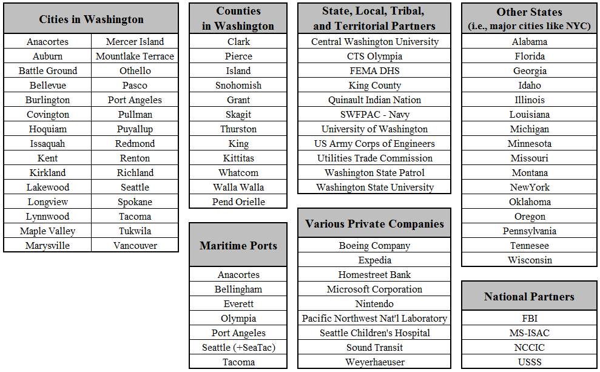
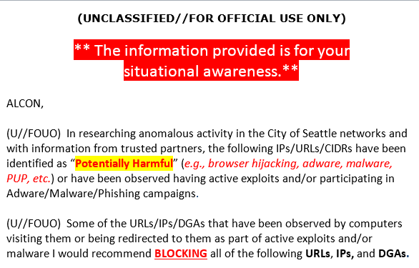
WSFC Shares Cyber Data / Threat Info
Notes:
Reaches specifically those entities that have asked to be on the cyber distribution list. In addition to NWWARN partners on our distribution lists.

Slide 26
Cyber Information Sharing
Cyber Liaison Officer Program
Similar to FLO program
Partner engagement, training, IOC, etc.
Currently in design phase – plan to deploy Q1 2018
In the meantime…
CIRCAS
Infragard
Agora
Emerald Down
PISCES (TBD)
DHS Cyber COP
Notes:
Future of Cyber in the WSFC
CIRCAS – Cyber Incident Response Coalition and Analysis Sharing group is a regional organization that is similar to the ISAC model, used with sector-specificity at the federal level. CIRCAS is focused on information sharing and analysis among members, which include federal law enforcement, state, local, and tribal governments, and many private-sector companies in Washington State.
Infragard – Member of the Evergreen Chapter, which is currently being reinvigorated.
Agora was initiated many years ago and is an association of several hundred people who work for public and private sector who share ways to detect, prevent, and deter cybercrime in the Pacific Northwest.
DHS Cyber Common Operating Picture

Slide 27
Cyber Performance Goal
Provide training for stakeholders
Threat activity, indicators, and response
Fusion Center Cyber Performance Level
Level 2a
Fusion Center produces cyber analysis based upon raw reporting and other local and national sources.
Fusion Center analysts have sufficient cyber knowledge to receive, relay, and analyze cyber incidents and reporting.
Fusion Center collects, writes and disseminates raw reporting.
Increase Outreach Capabilities
Write cyber analytic products (CP-3)

Slide 28
Contact
Washington State Fusion Center
Allen Avery
Allen.avery@wsfc.wa.gov
www.wsfc.wa.gov
Intake@wsfc.wa.gov
877.843.9522
Notes:
We hope this overview was beneficial and gives you a better understanding of what the fusion center currently handles as well as what where we are heading in the coming months. Again, if you need to reach us or would like to discuss in more detail any of the items covered in this presentation please don’t hesitate to reach out to us at the contact information on the screen.
Additional information concerning the Fusion Center is available on our public facing website
And, as a reminder, please report Suspicious Activity to the fusion center at intake@wsfc.wa.gov or 877-843-9522.
With that, are there any questions or comments?

Slide 29
QUESTIONS ?
Notes:
Thank you for your time and enjoy the rest of your day.

Slide 30
U.S. Coast Guard
Lessons for the Maritime Community
USCG & Maersk - APM Joint Response to
Cyber Incident
LCDR Eileen Beck
Thirteenth Coast Guard District (drmt)

Slide 31
Maritime domain subsector of transportation systems sector
Critical Infrastructure Sectors
The USCG has the primary responsibility for the safety, security, and environmental protection of the maritime domain, including enforcing customs and immigration laws at sea, managing the responses to incidents impacting the Federal navigable waters and ports, and coordinating and expediting the recovery of maritime transportation system.
Presidential Policy Directive 21 (PPD-21)
Notes:
The USCG has the primary responsibility for the safety, security, and environmental protection of the maritime domain, including enforcing customs and immigration laws at sea, managing the responses to incidents impacting the Federal navigable waters and ports, and coordinating and expediting the recovery of maritime transportation system. The USCG engages these responsibilities through a network of 43 Area Maritime Security Committees (AMSCs) in each Captain of the Port zone. The AMSC’s are the cornerstones of security in the Nation’s ports. In addition, the USCG benefits from the contributions of several advisory committees and other industry engagement forums.
“The term "critical infrastructure" has the meaning provided in section 1016(e) of the USA Patriot Act of 2001 (42 U.S.C. 5195c(e)), namely systems and assets, whether physical or virtual, so vital to the United States that the incapacity or destruction of such systems and assets would have a debilitating impact on security, national economic security, national public health or safety, or any combination of those matters.” Presidential Policy Directive 21

Slide 32
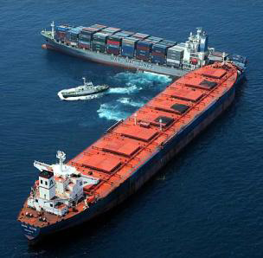
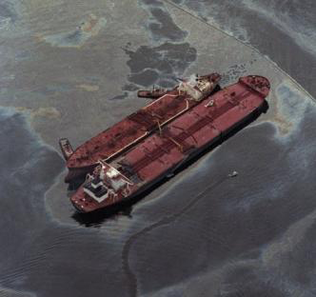
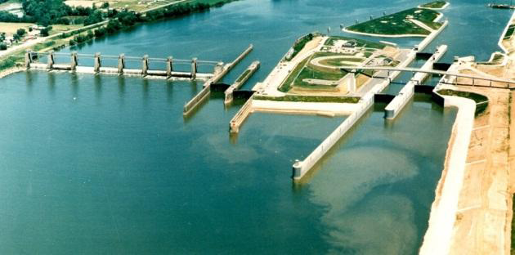
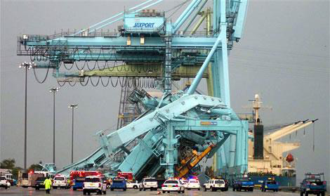
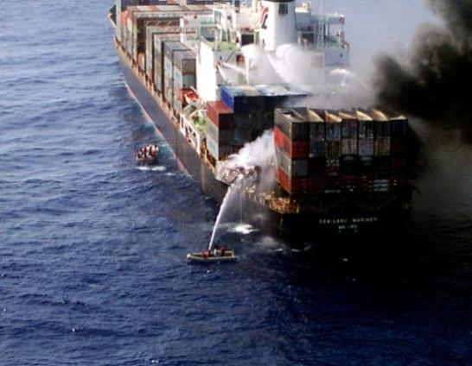
Potential Range and Impacts of Exploiting Cyber in MTS
Direct physical damage
Local MTS disruptions
Injury or death
Catastrophic disruptions to the MTS
32
Notes:
In addition to the compromise of personal information and financial risk, its important to understand the physical effects that a cyber attack can have. These range from damage to a single piece of equipment to potential catastrophic disruptions to the transportation system and personnel casualties.
If not already, it will become clear to you as we proceed through this presentation that the physical impacts of a cyber attack represent the evolution of the cyber threat.
The rate of change regarding critical infrastructure cyber risk is quite notable – in the last year, public reports of targeted attacks specific to water, energy, transportation, and pipelines are increasing. Some of our most critical infrastructure depend on technology that was not designed to ward off the types of attacks we are seeing today. In general, it has been said that the time between a hack attack and finding out is about 7 to 8 months. The frequency and capability for severe attacks is on the rise.
85% of consumable products come from ports, any interruptions will cause supply chain disruptions to Boeing, wholesale to local markets

Slide 33
Policies
NVIC 05-17 Cyber Risk at MTSA-regulated facilities
Evaluate threats, vulnerabilities and consequences
NIST – Cyber Security Framework 1.0
Comment period extended: Oct 11
MSC-FAL 1/Circ 3 (SMS incorporate Cyber Risk by 2021)
Notes:
-NVIC in draft format, recommended practices for prevention by facilities – they recognize their vulnerabilities and threats and develop a plan to prevent or react -> that plan is reviewed by inspectors and AMS (Mimi Bolofi, executive secretary of area maritime security committee) (remember MST1 Hagerty will be in audience to address specfics of case)
MAERSK segregated dangerous cargo and farwarded freight by hand.
Sector Puget Sound worked with VTS to notify inbound vessels of potential delays

Slide 34
Maersk - APM Cyber Incident
June 27, 2017 Maersk/APM shipping company suffered a global operations attack from the Petya Ransomware malware
NRC/NCCIC reports received from APM New York and Florida @ 0730
NRC/NCCIC report received from Maersk Norfolk Comms office @ 0810
NRC/NCCIC report received from APM facility in Mobile, AL @1100
Contact with APM facilities in Los Angeles and Tacoma indicate mandatory shutdown of all systems and company phones @ 1125
First media reporting of Petya began @ 1235
+70 hours - CG-FAC makes contact with Maersk CISO for Americas –Charleston SC
Containers and cargo docs being done manually for 10 days.
Backend Technologies with company in disarray for 6 weeks
CG conducted 3 Hot washes of the event to create an extensive Lessons Learned document, and have already enacted 5 significant changes/updates as a result
Notes:
How did the notifications come through? Did NRC and NCCIC (National Cyber Security and Communications integration center) work well together? NCCIC can do cross threat sectors energy to banking etc. power heathcare.
If in doubt NRC will forward to NCCIC. Phishing, IT/OT technology.
First detected in Copenhagen- called facilities and directed hard shut down
10 days until basic functionality back online
6 weeks backend
- caused scripting errors, had to repair system
- switched to Windows 10, expedited already planned transition
Power shutdown- mail processess- can take time – domain controller- mail – user authentication, sequel server
Denmark made the decsion – corporate headquarters
The ransomware was moving on it’s own with no user intervention
West Coast protected by decsion
FSOs were called and told to secure workstations
That impacted ability to contact CG
Injected by backdoor review- updates from a third party are not inspected- CG DOD does inspect updates to ensure clean code.
-Impact: closed automated gates, were not allowed to go through with proxy cards
Reverse CIC call to inform local units of information that may be held at a higher level, assist with local Sectors doing their job and understanding scope of issue
Provided an opportunity for the CG to see actual impacts of cyber intrusion: access, freight forwarding, dangerous cargo segregation, vessel delays
- NCCIC what do they do?
- Special note here of how long it took to get a hold of the US CISO for Maersk (had bottom up communication in the past, but having a higher level communication with CISO was key) his personal cell phone number was on the plan
- (Notes: Phones were VOIP, so went down when servers were shutdown)
- (still requires validation) 5: 1. new QRCs

Slide 35
Lessons Learned
Patched /updated systems are still vulnerable to Cyber attacks. (Malware distributed through a Ukrainian accounting/filing tax software MeDoc; backdoor into the network software- automatic updates)
Global supply chain: Ensure suppliers are accountable. Think NIST CSF 1.1
Printed storage of key contacts is a MUST
Notes:
Dichcotomy between Dod and public
- Maersk was compliant with NIST 1.0 (nothing requires them to be complaint with NIST)
Kapersy or other eastern block products could have risks- trustworthyness; 13SEPT DHS issued directive requiring removal of (previously approved system) Kaspersky anti-virus software
This came out of the lessons learned
This was pretty challenging keeping the national picture- APM is a subsidiary of Maersk- they did not have all the information
Move to other piers to prevent – interruptions- park and offload- some customs issues and likewise with the departures
CBP waived the 24 hr rule

Slide 36
Lessons Learned
Review your system architecture: What systems are going to be unavailable during an extended outage. (i.e. VOiP, Security, Access Control Systems, etc.)
Consider internal system (server or data center) shutdown procedures. Safe shutdowns = easier restoration. Extreme shutdowns = Days of rebuilding production equipment
Importance of timely voluntary reporting to NCCIC, NRC
Notes:
Personal cell phones were used via the NRC report
Not all of the facilities were arranged in the IC versus admin – LA was separated out. No breech of West Coast facilities
CG was quick at getting their info up to us. The Maersk vessels were not infected

Slide 37
Best Practices
Fast Isolation: Quickly identified the lateral movement vector of Petya, and made the decision to shut down their entire global system
Restoration Plan: High TEU facilities first, minimize global supply chain disruption
Communicate with CG and Maritime Partners: APM provided continual updates on physical cascading effects of the facility to avoid commerce delays
System Architecture: Vessels were protected by being on entirely separate network
Notes:
Expedited windows 10 update- 90K workstation- cost thing
Vessels were on a completely different network

Slide 38
Impacts
Business losses ~$700M!
Copenhagen Stock Exchange trading began selling off into the early stages of the event, but gained neutral territory over the following 48 hours.
Favorable reputation has remained consistent to date
Maersk will continue to be a key case study in Maritime Cybersecurity
Wake up call for Global Maritime community in how it addresses Cyber Risk Management overall
Notes:
Perfect scenario for ex planning- highlights key features, commerce, cargo delays, notifications,
No official classification
- (business losses are estimates, from NY Times article)
-

Slide 39
Resources for Risk Assessment and Mitigation
Cyber Education and Awareness
Cybersecurity Advisor Services
Preparedness
Strategic Messaging
Working Group Support
Partnership Development
Cyber Assessments
Infrastructure Survey
Resilience Review
External Dependency Management
Notes:
National Protection and programs directorate (NPPD)

Slide 40
“As shipping moves towards innovations such as autonomous vessels the US Coast Guard (USCG) warns that the industry needs to take cyber security seriously to avoid regulation.”
Cyber is Serious Business
“Take cyber security seriously or face regulation USCG warns shipping”
-Admiral Nadeau 2017 Safety at Sea Conference Singapore
Notes:
Senior Leadership within the Coast Guard is saying, ‘we know you want to prevent an incident and are motivated to continue operations; we want to work together to prevent incident

Slide 42
Thank You for your time!
Further inquiries:
LCDR Eileen Beck, D13 drmt
(206)220-7157
Eileen.Beck@uscg.mil
Mr. Jason Warren CG-FAC
CISSP, ITIL, CE|H, MCSE, CCNP, A+, Security+
Jason.S.Warren@uscg.mil
202-372-1106

Slide 43
Cybersecurity Workshop December 7, 2017
Information Security & Privacy Insurance
A Anne Shackelford
Vice President, Public Entity Practice Group
anne.Shackelford@alliant.com
Doug Selix
Department of Enterprise Services
State of Washington
December 4, 2017

Slide 44
“It takes 20 years to build a reputation and five minutes to ruin it.”
- Warren Buffet

Slide 45
Cybersecurity Policies
Policy Limits: $1M Per Occurrence up to $500M
Insurance Carriers: 60+ Markets (Domestic & Foreign)
Policy Aggregates:
Depends on market - Typically twice the Per Occurrence Limit
Retention/Deductible:
As low as $500 for small businesses; whereas large-limit, Cybersecurity policies at least $10,000; often much higher according to risk profile
Coverages:
Legal Liability for loss or unauthorized disclosure of Personally Identifiable Information/Personal Health Information, etc.
Failure to timely disclose loss (every state has their own time period)
Damages and Claims Defense
IMPORTANT: ACCESS TO DATA BREACH COACH/STAFF AND OTHER EXPERTS!
Notes:
Attorney/Client privilege!!!
Mention Underwriting – can be tedious and time consuming especially the first go around. Underwriters are not IT experts. Admittedly they don’t always ask the right questions the right ways. Direct discussion w/ underwriters go along way to move the process along. If they get stuck with underwriting… HAVE A CONVERSATION DIRECTLY.

Slide 46
Cybersecurity Insurance Carriers
Top 10 Writers Of Cybersecurity Insurance Written in 2016⁽¹⁾
($000)
Rank | Group/company | Direct premiums written | As a percent of total
1 | American International Group | $228,325 | 17.0%
2 | XL Group Ltd. | 160,809 | 12.0
3 | Chubb Ltd. | 133,599 | 10.0
4 | Travelers Companies Inc. | 92,189 | 6.9
5 | Beazley Insurance Co. | 83,908 | 6.3
6 | CNA Financial Corp. | 68,476 | 5.1
7 | BCS Insurance Co. | 55,411 | 4.1
8 | AXIS Capital Holdings Ltd. | 50,273 | 3.7
9 | Liberty Mutual | 34,343 | 2.6
10 | Allied World Assurance Co. | 32,533 | 2.4
(1) – US Based Carriers (not including Lloyds, etc.)
Notes:
WHO IS WRITING THE COVERAGE?
(1) Includes stand-alone policies and the cybersecurity portion of package policies. Does not include premiums from companies that cannot report premiums for cybersecurity coverage provided as part of package policies. (2) Direct premiums written in the U.S. and its territories, Canada and other foreign territories.
Source: NAIC data, sourced from S&P Global Market Intelligence, Insurance Information Institute.
- - For example, if Beazley’s # included its Lloyds syndicate writings, they would likely be # 2 or 3.

Slide 47
Good vs. Bad Policies
Quality of policy matters
Be mindful of Policy Terms and Conditions
Low quality carrier = claim payout risk
Low priced policy = get what you pay for?
Appropriate Privacy/Cyber/Data Liability Coverage
READ the policy; understand exclusions
Sub-limits
Table-top Exercises work
Prepare for likely possibility that you will be impacted at some point by this risk
Notes:
If low cost is the only motivator, expect low quality policy.
Partner with well-respected brokers in the industry to find the RIGHT placement for you.
Savvy insurance broker who represents BUYER/INSURED can guide the market; an agency who represents the carrier not as engaged.

Slide 48
Handling the Breach
Beazley Breach Response Services Unit
Managing breach incidents since 2009
2014 – Handled 880+ incidents
2015 – Handled 1200+ incidents
2016 – Handled 2000+ incidents
At end of 2016, handled 5000+ incidents
Source: Beazley – 2015/2016 statistics
Notes:
This isn’t a commercial for Beazley BUT…
This illustrates the increase in security breaches occurring relative to prior years. Granted, could partially be due to increased awareness and actual purchase of insurance such that they’re being formally tracked.

Slide 49
Handling the Breach
Breach Resources from a Cybersecurity Policy
Access to Legal Experts
Hiring a forensics expert to determine existence and cause of Security Breach
Provide notification in compliance with Breach Notice Law
Public Relations Assistance
Credit Monitoring (for X years for impacted parties

Slide 50
Claim Examples
Doug Selix
Department of Enterprise Services
State of Washington

Slide 51
Cybersecurity Policy Works
First Policy 2014
Breach Experiences
HCA (APIP Beazley)
DFW (APIP Beazley)
WSU (Beazley Private Policy)

Slide 52
State Insurance Coverage

Slide 53
Recommendations
A small policy will get you access to resources
Legal
Notification and Credit Monitoring
Forensic Investigation Support
Get Risk Management & IT working together
Combined Incident Response Planning

Slide 55
Cyber Reserve Corps – Washington State Concept, Best Practices from Michigan, and Stakeholder Input
Panel:
Moderator: Jodie Ryan, Corporate Information Security, T-Mobile
Col. Kelly Hughes, Senior IT Security Advisor, Washington State Military Department
Ray Davidson, Office of the CSO, Michigan Cyber Civilian Corps (MiC3)

Slide 56
Colonel Kelly Hughes
Senior Cyber Security Advisor
WA Air National Guard
16 November 2017

Slide 57
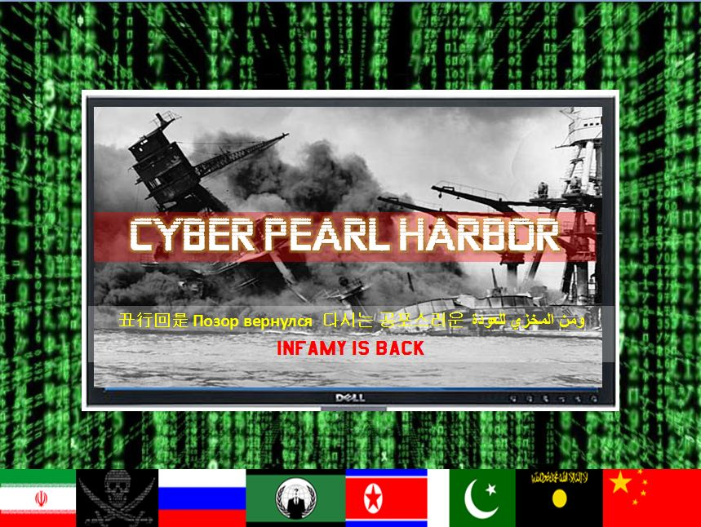
How would you respond?

Slide 58
What happens when YOUR IT is tapped out?
Managing issues….
With
resources?

Slide 59
Current Response for cyber incidents
Title 10
Other Govt Agencies
State of Washington
- Request to US Cyber Command For assistance
* Would have to compete with National Defense priorities for a Cyber Mission Force Team
- Request to DHS for Assistance
* Hunt & Incident response teams (HIRT)
**low density, high demand resource
-State Guard Cyber
- State EMD
- Air and Army National Guard teams Not training for or on Title 10 Federal Missions
(Pick up game)

Slide 60
WA proposal – Dedicated State Mission Assurance Teams
SLTT Partners
Exercises
Cyber Hardening
Resiliency Training
Dedicated 10-person Cyber Team
Local Response
Local Presence
Build cyber Resilience
Incident Response
Technical Skills
Civil and Military Trained
Trusted
Cyber
Incident Response
CIKR owners
Focus on protecting Critical Resources and Infrastructures that feed our Federal partners

Slide 61
The Cyber Civil Support Team initiative
Provides the connective tissue that does not exist today with Federal and DoD Cyber command and operations centers for the state
Build resilience through joint training, system hardening and regular LOCAL interaction
Serves to provide Mission Assurance of our DoD forces stationed within the borders of Washington to secure the 85% of the critical infrastructures they depend on but do not control

Slide 62
AUni
Unity of Effort
Local presence & National Synergy
Federal
State
Public/Private
Cyber Civil Support Teams
We cant afford to rely on this
We need this for an effective response

Slide 63
Tabletop Scenario and Report-out
Scenario:
Your security operations center determines that a critical finance server has been infected with ransomware. This is a result of an employee clicking on what appeared to be a legitimate expense link that turned out to be a targeted phishing email. Once the employee entered their credentials into the link contained in the phishing email, their account was compromised. The malicious actor was then able to remotely access their 0365 mailbox. From there, the malicious actor sent out over 500 additional phishing emails internally from the compromised account, including to the CFO. The phishing emails contained ransomware which was opened and executed by a number of users. The user’s machines began spreading the ransomware to other hosts that were not patched, including to 50 servers. All affected laptops and servers are currently encrypting their drives. Please explain the decision tree and workflow of your triage and reporting process for this scenario.

Slide 64
Tabletop Scenario and Report-out
Questions:
Do you have a surge planning incident command system or staffing/comms plan for such a scenario?
Does your organization have the following trained individuals available for a significant incident response that overwhelms your entity’s resources?
Cyber Incident Response Team Lead
Threat Intel Incident Response Lead
Major Incident Management Incident coordinator
Engineering Incident Response Lead
Corporate Communications
HR
Legal
Government Affairs
Does your current business continuity plan cover this scenario? Would you have access to the technical resources needed to respond to the incident, or (if these resources are not in-house) do you have current network diagrams that can be provided to responders?

Slide 65
Discussion on Cyber Reserve Corps
What would your expectations be if you called on the cyber reserve corps for help? Would you call for help? At what point during an incident would you request help from the reserve corps?
How do we create a sustainable funding/management model for a cyber reserve corps? Is there a governing body that exists already or is it an entity that needs to created?
What legal frameworks are currently in place to support a cyber reserve corps? And what new frameworks need to be created (i.e. new legislation, agreements, etc.)? What legal barriers exist (i.e. privacy of vulnerability data, concerns over liability, etc.)

Slide 66
Thank you for attending!
Next Steps
Upcoming Events
Blue Cascades VII Recovery Exercise – March 2018
Idaho Cyber Workshop – April 2018
Maritime Cyber Security Project – September 2018
Long-term Power Outage Workshop – 2019
Please remember to fill out feedback forms!

